Slide 1
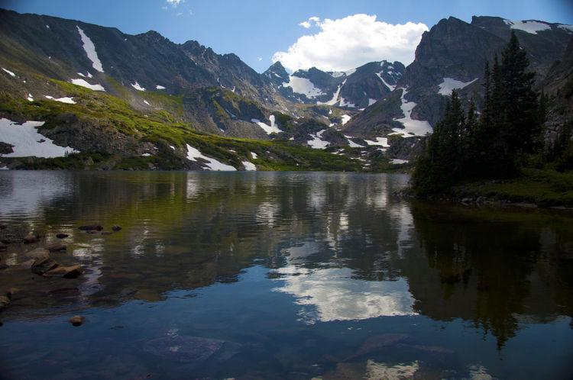
Predicting Forest Cover Type
Supervised Learning Capstone
By: Montanna Colburn
Notes:
https://github.com/MontannaColburn/Thinkful_DataScience_Bootcamp/blob/master/Unit%203/Supervised_Learning_Capstone.ipynb

Slide 2
Research Question
Can we predict forest cover type based on the surrounding characteristics?
What are the most commonly seen cover types?
Do certain cover types grow best under certain conditions?
What are the most important attributes in predicting cover types?
Practical Use? Could help in forest regrowth and preservation.

Slide 3
Dataset
Kaggle Dataset
https://www.kaggle.com/uciml/forest-cover-type-dataset
Multi Classification: 7 potential cover types
581,012 observations of 30m x 30m patches of forest floor in Roosevelt National Forest
No nulls, and all int values (aka minimal data cleaning!)
The data collected is from areas with minimal human disturbances, so that cover types are more likely correlated to ecological processes

Slide 4
Dataset Continued
Total of 55 columns
Continuous:
Elevation: Elevation in meters.
Aspect: Aspect in degrees azimuth.
Slope: Slope in degrees.
Horizontal_Distance_To_Hydrology: Horizontal distance to nearest surface water features.
Vertical_Distance_To_Hydrology: Vertical distance to nearest surface water features.
Horizontal_Distance_To_Roadways: Horizontal distance to nearest roadway.
Hillshade_9am: Hill shade index at 9am, summer solstice. Value out of 255.
Hillshade_Noon: Hill shade index at noon, summer solstice. Value out of 255.
Hillshade_3pm: Hill shade index at 3pm, summer solstice. Value out of 255.
Horizontal_Distance_To_Fire_Points: Horizontal distance to nearest wildfire ignition points.

Slide 5
Dataset Continued
Total of 55 columns
Categorical:
Wilderness Area (4 dummy variable binary columns, 0 = absence or 1 = presence)
Soil Type (40 dummy variable binary columns, 0 = absence or 1 = presence)
Notes:
Wilderness Area Key:
Rawah Wilderness Area
Neota Wilderness Area
Comanche Peak Wilderness Area
Cache la Poudre Wilderness Area

Slide 6
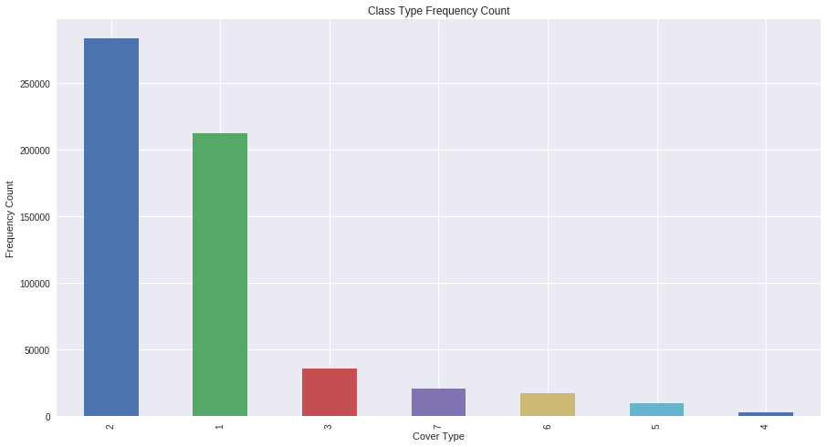
Data Exploration/ Visualization
Distribution of Target Variables: Class imbalance
Forest Cover Type Key:
1.Spruce/Fir
2.Lodgepole Pine
3.Ponderosa Pine
4.Cottonwood/Willow
5.Aspen
6.Douglas-fir
7.Krummholz

Slide 7
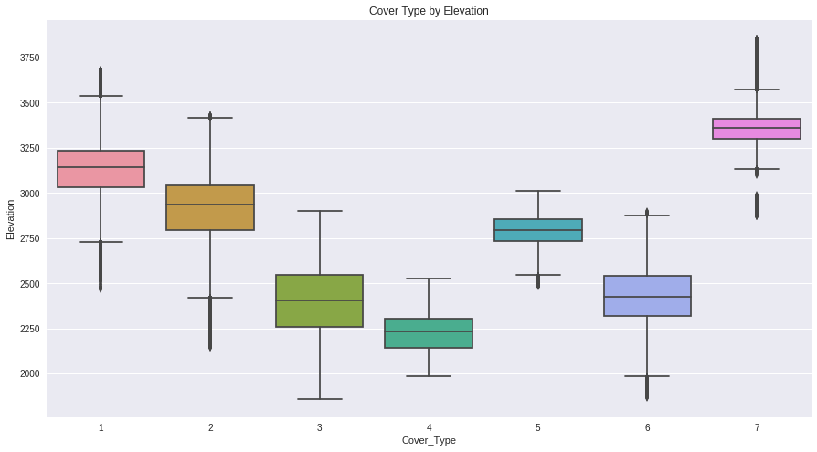
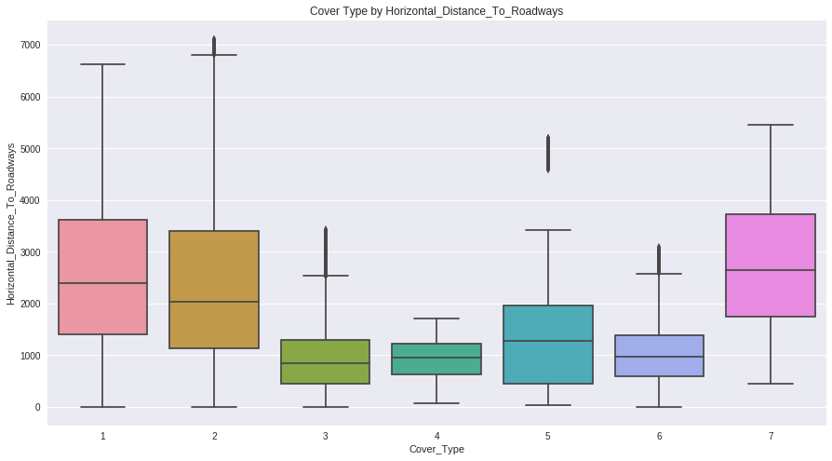
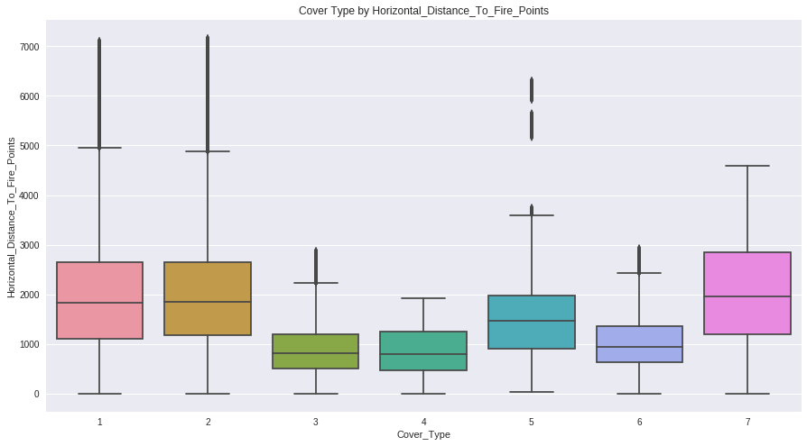
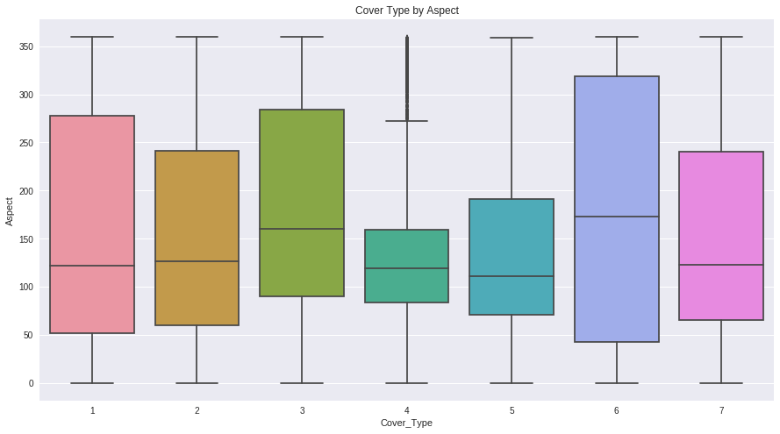
Data Exploration/ Visualization
Distribution of Continuous Variables by Target Variables
Variables that are likely to be good indicators of cover type due to the variability amongst floor coverings:

Slide 8
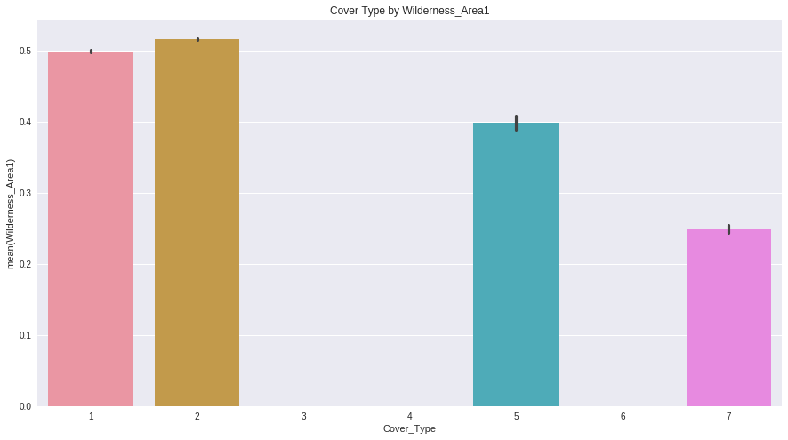
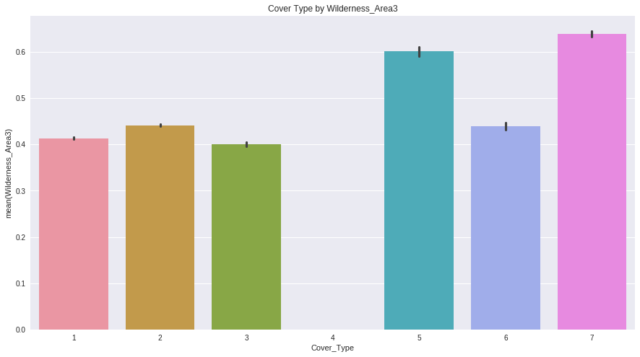
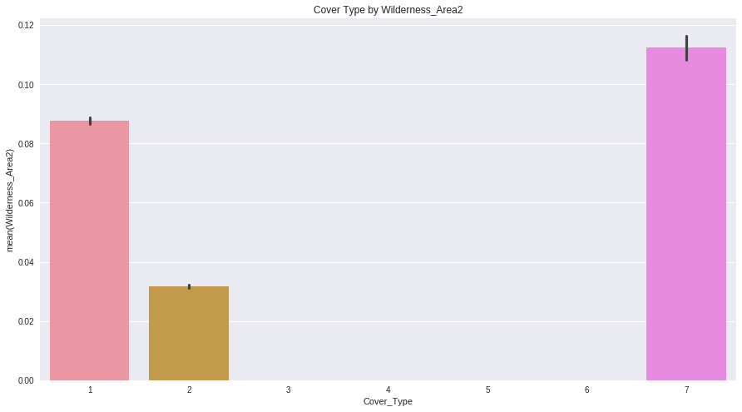
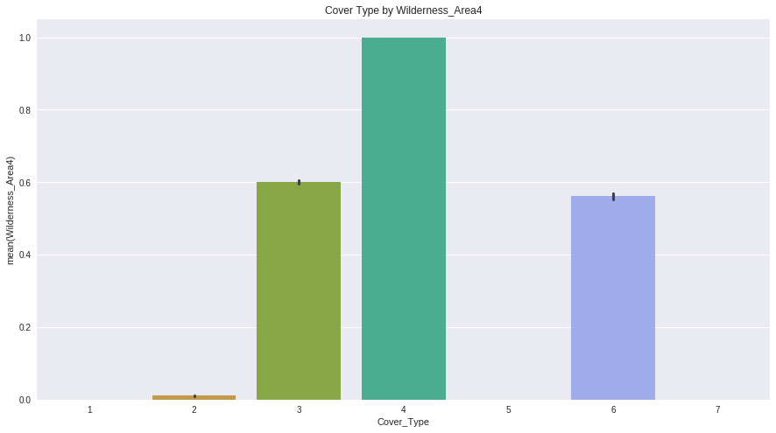
Data Exploration/ Visualization
Distribution of Categorical Wilderness Area by Target Variables
Certain wilderness areas are more likely to have specific kinds of forest cover type than others, so this will likely be a good indicator for our prediction model:

Slide 9
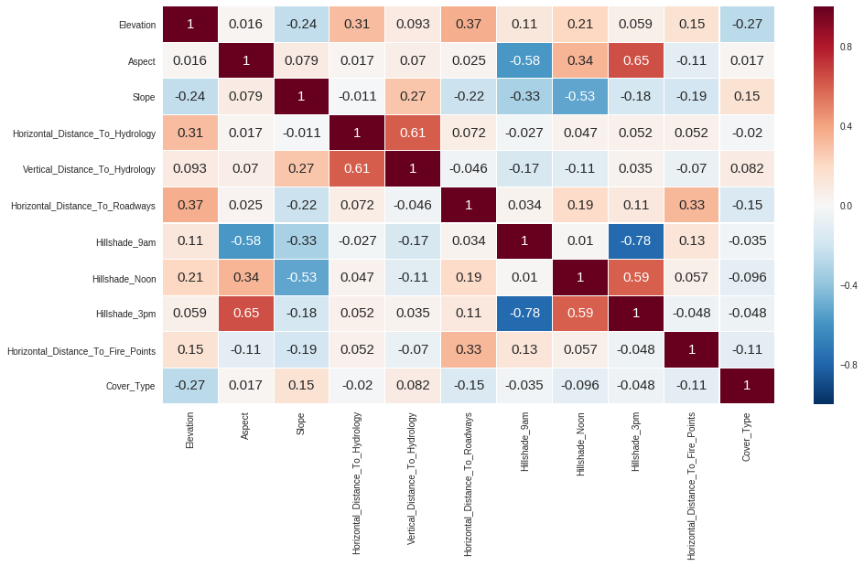
Data Exploration/ Visualization
Continuous Variable Correlation Matrix
Aspect & Hillshade_3pm, Horizontal_Distance_To_Hydrology & Vertical_Distance_To_Hydrology, Hillshade_Noon & Hillshade_3pm, and Hillshade_9am & Hillshade_3pm are relatively correlated.
We’ll use a .90 threshold for removal of correlated variables, and thus we won’t be removing any of these, as we won’t account for too much variance or overfit our model from this.

Slide 10
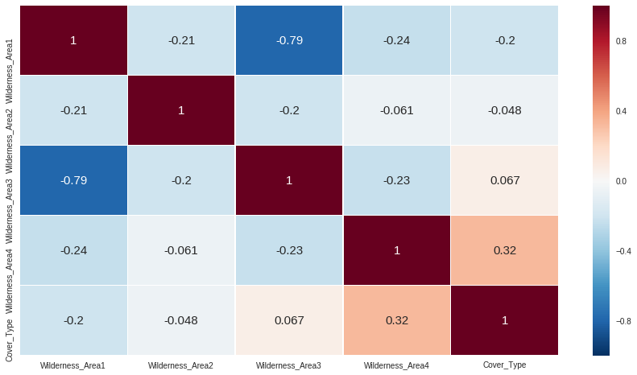
Data Exploration/ Visualization
Categorical Variable Correlation Matrix: Wilderness Area
Looks pretty good! These aren’t too very correlated, other than wilderness area 3 and 1 being inversely correlated.
Again, doesn’t surpass our .90 threshold for removal, so we’ll be keeping all of these.

Slide 11
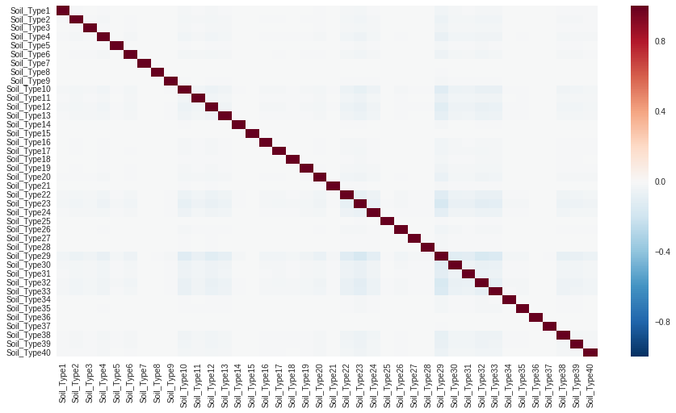
Data Exploration/ Visualization
Categorical Variable Correlation Matrix: Soil Type
This looks great! Seems that our soil types differentiate from one another rather well.

Slide 12
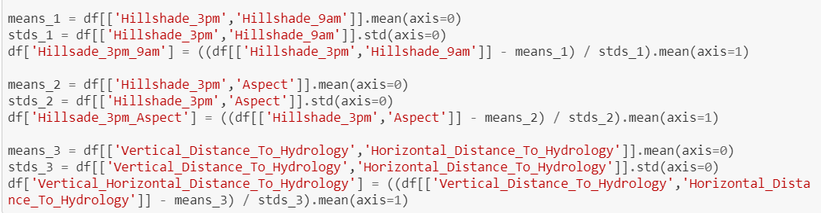
Feature Engineering
Binary variables already one hot encoded, called for less feature engineering
Performed some minor feature engineering combining correlated variables
Will later see how they fare in feature importances

Slide 13
Models
Logistic Regression
Random Forest Classifier
XGB Classifier

Slide 14
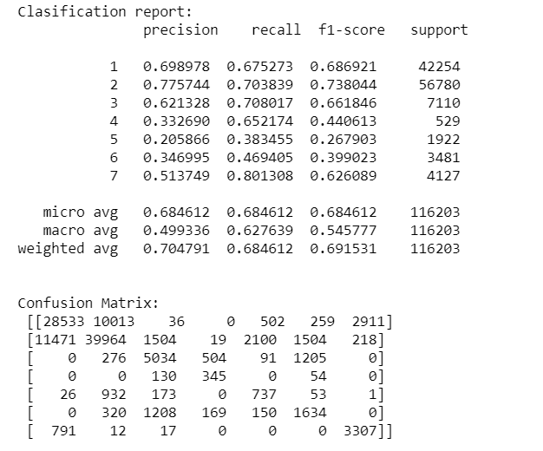
Models
Logistic Regression
Basic Model CV : ([0.64608655, 0.66651129, 0.65699738, 0.67722154, 0.65584881])
Best Parameters: {'penalty': 'l1', 'C': 1600}
class_weight: 'balanced'
Test Score: 0.684612273349225 --- 0.2860429286956787 seconds ---
ROC_AUC: 0.7799067448276092

Slide 15
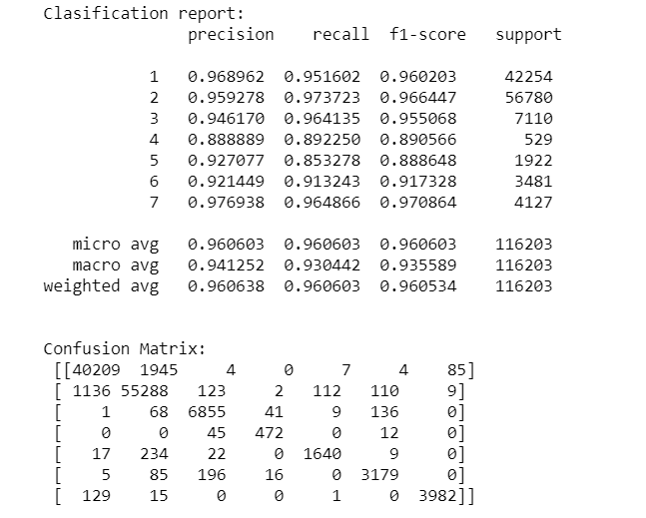
Models
Random Forest Classifier
Basic Model CV: ([0.86205227, 0.86834463, 0.86182229, 0.86332831, 0.86416698])
Best Parameters: {'bootstrap': False, 'max_features': 8, 'min_samples_split': 4, 'n_estimators': 500}
class_weight: 'balanced'
Test Score: 0.9606034267617876 --- 36.92564153671265 seconds ---
ROC_AUC: 0.9605518598460694

Slide 16
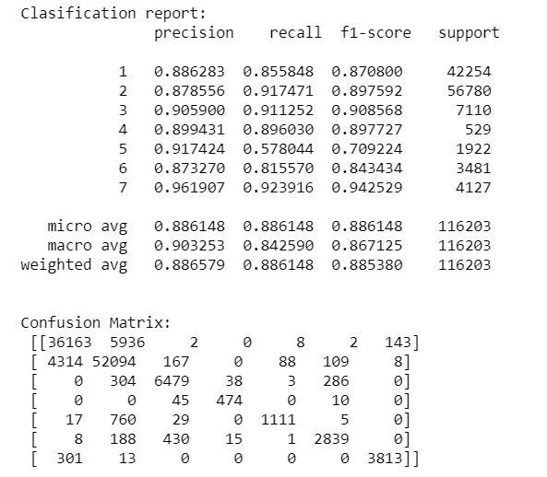
Models
XGB Classifier
Basic Model CV: ([0.7013015 , 0.69984941, 0.69755809, 0.69658993, 0.69293668])
Best Parameters: {'subsample': 0.7, 'max_depth': 9, 'colsample_bytree': 0.9, 'colsample_bylevel': 0.9}
Test Score: 0.8861475177060834 --- 9.213517189025879 seconds ---
ROC_AUC: 0.9072641409037657

Slide 17
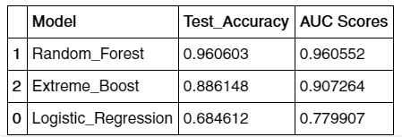
Model Comparison
Random Forest predicts the forest!

Slide 18
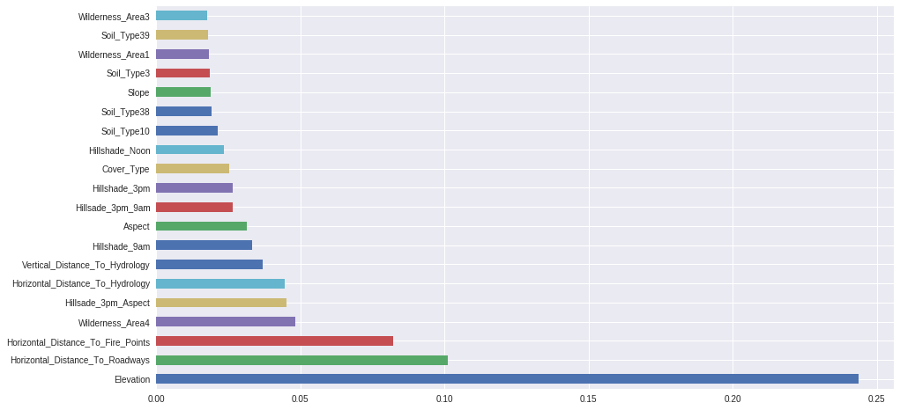
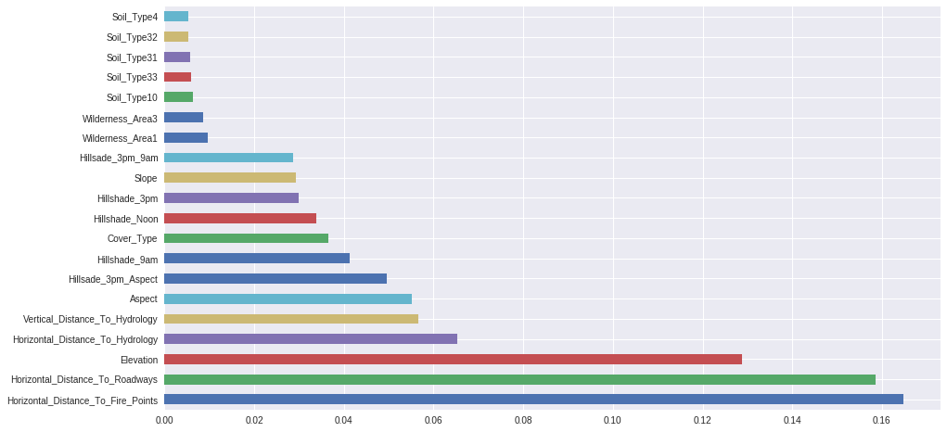
Feature Importances
Random Forest
XGBoost

Slide 19
Conclusion
We can see that our top three important features amongst both our Random Forest and XGBoost Classifier were Elevation, Horizontal Distance to nearest roadway, and the Horizontal Distance to nearest wildfire ignition point.
Our top performing model was Random Forest with a 96.06% on the test set, and an average of .9605 for an AUC score, though with the longest execution time. Logistic Regression proved to be the least effective predictor with a score of only 68.46% on the test set, though quicker than the rest in speed.

Slide 20
Future Work
Select the best features found through our XGBoost Classifier and Random Forest model in an attempt to achieve the same results with less computational power necessary and dimensionality reduction.
Attempt to adjust the tuning parameters on the extreme boosting model, considering the max values ended up as our best params, to see if we could perhaps surpass the score of our Random Forest Classifier.
Incorporate scale_pos_weight in XGBoost random search for optimization of class imbalance

Slide 21
Questions?

